Slide 1
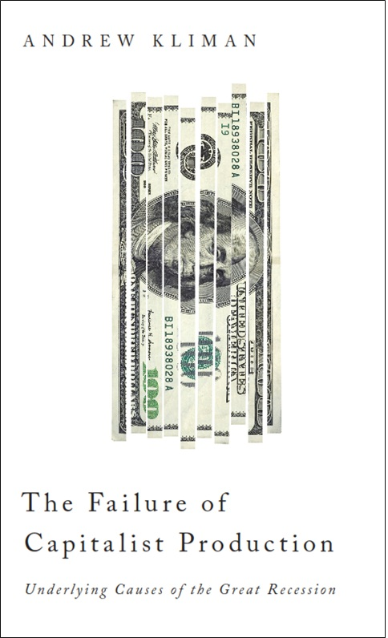

Slide 2
2007 ‘08 ‘09 ‘10 ‘11 ‘12
pani
c
FINANCIAL CRISIS
N
GREAT
RECESSION
“THE NEW NORMAL”
United States, since 2007

Slide 3
Paul Krugman & Robin Wells, Sept. 2010:
“If the fundamental problem lay with a crisis of confidence in the banking system, why hasn’t a restoration of banking confidence brought a return to strong economic growth? The likely answer is that banks were only part of the problem.”

Slide 4
In U.S., since start of Great Recession:
Employment 5 million
Working part-time
but want full-time work 3 $\frac{1}{2}$ million
Missing job growth
(to keep up with 6 $\frac{1}{2}$ 8 million
growing population)
Total full-time job loss 15 16 $\frac{1}{2}$ million

Slide 5
Conventional Left Account
turning-point of recent U.S. economic history: rise of neoliberalism in early 1980s
workers’ share of income, and real pay, declined
causing the rate of profit to rebound
so the economy could have grown rapidly, if the extra profit had been invested in production

Slide 6
But financialization occurred:
profit diverted from productive investment
toward financial speculation
so
slow economic growth
rising debt burdens
setting stage for
financial crisis and Great Recession

Slide 7
Yet I found:
the turning-point was the 1970s – before the rise of neoliberalism
the rate of profit never recovered from the fall of the late 1970s and early 1980s
the rate of accumulation fell because the rate of profit fell, not because profit was diverted from investment in production
workers’ share of income has been stable, and their real compensation has risen, during the last 40 years

Slide 8
The 1970s as Turning-Point:
Relative Stagnation Since Then
1969: rise in income inequality starts
1969: fall in growth rate of public
infrastructure spending starts
c. 1970: rise in Treasury and household
borrowing (as % of GDP) starts
1971: collapse of Bretton Woods system:
leads to rise in price of oil (1973- )
and 3^{d} World sovereign-debt crisis
& defaults/restructurings

Slide 9
c. 1974: start of worldwide fall in GDP growth
& fall in growth of US GDP &
industrial production
c. 1974: start of fall in growth rate of
workers’ pay
c. 1974: rise in labor-force dropout rate starts
1975: rise in average duration of
unemployment starts

Slide 10
generation of profit → productive investment of profit
rate of
rate accum- econ-
of ulation omic
profit (productive growth
investment)
gov’t & Fed
policies to
counteract
debt
crises,
burst bubbles
debt burdens

Slide 11
actual
w/out fall in corp. inc. tax rates & ratio of profit to GDP
U.S. Treasury Debt (% of GDP)
.

Slide 12
Rates of Profit, U.S. Corporations, 1929-2009
(profits as % of historical cost of fixed assets)
net value
added – compen-
sation
before-tax
profit

Slide 14
U.S. Multinationals’ Rate of Profit on
Foreign Direct Investment, 1983-2010
(after-tax profit as % of FDI)

Slide 15
The Rate of Profit & the
Rate of Accumulation, 1970-2009
ROA
ROP

Slide 16
% of After-Tax Profit Re-invested
in Production, U.S. Corporations

Slide 17
% of Profit Re-invested in Production,
U.S. Corporations
net value
added –
comp.
net oper- ating
surplus
before-
tax
profits
after-
tax
profits

Slide 18
Current-cost “Rate of Profit,” U.S. Corporations
net value added – compensation

Slide 19
Profit Share of U.S. Corporations’ Output, 1947-2009
[(net value added – comp.) as % of net value added]

Slide 20
Workers’ Share of U.S. National Income, 1960-2009

Slide 21
Real Compensation, U.S. Private-Industry Workers, % of 1985 level
(compensation deflated by PCE price index; figures for Dec. of indicated year)

Slide 22
Growth Rates, Avg. Annual, U.S. Corporations

Slide 23
“share the wealth” struggles face strict limits
the wealth has not been there to share
the latest crisis has exacerbated this problem
struggles to protect & enhance standard of living
CAN succeed
but they will lower profitability further,
making the system even less stable
& prone to severe crises and recessions

Slide 24
Prospects
full-scale destruction of capital value
new boom, or collapse, or revolution
more “kicking can down road”
—papering over bad debt with more debt
continued sluggishness, recurrent crises
as debt mounts, U.S. & other gov’ts’ ability to restore confidence declines
socialism

